Slide 1
Self Service Publishing Project
Patrick Desbrow
Measure Tollgate Review

Slide 2
BPM Project Summary
Problem Statement
As of some date December 2010, the [J. D. Power] Client System Group (CSG) spends approximately 22 hours or $2,000 to publish a single study on the existing Business Center web deliverable.
Currently, there are too many individual steps in a single study. The existing process is manual and requires unnecessary IT staff to ensure accuracy.
In addition, the number of reported errors in the publishing process indicate potential issues with quality.
Defect Definition/Project Metric
D1: Labor Hours > $1,000
D2: # of Errors > 1
Objective
The aim of this project is to
Decrease this by 50% or 11 hours of labor for a syndicated research study by December 2011.
Reduce the number of reported errors on a study to less than or equal to one.
Leverage standardization and automation.
Standardization allows us to do the same thing the same way which also allows for the automation of common tasks.
This will lower cost and allow for more research deliverables.
Projected Benefits
Based on a current project chargeback rate of $90 per hour, it is estimated that this project would remove $1,000 from a study.
With over 300 Syndicated studies published on the Business Center in 2010, there is the potential for an estimated $300,000 savings each year.
The reduction of reported errors on each study will increase the overall quality of the study.

Slide 3
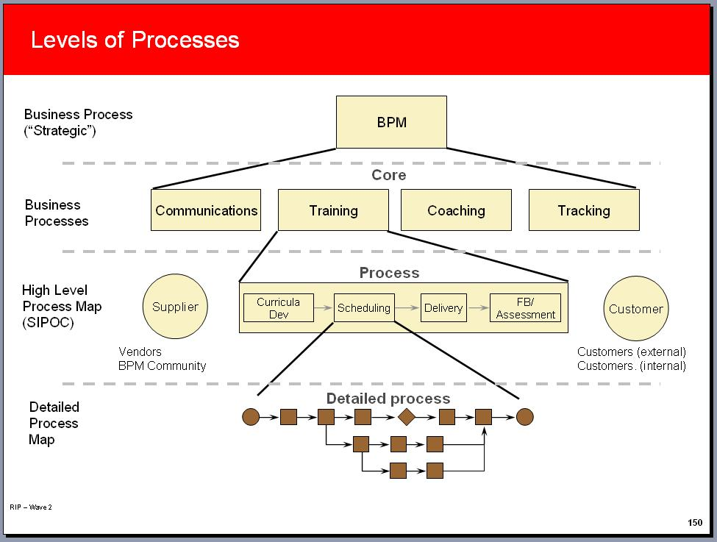
SIPOC/High level view
The focus for this project is at the end of the research process when different sources of data are delivered to the application development team in the Client Systems Group (CSG).
A detailed SIPOC mapping has been created. (Please refer to the attachment)
Suppliers: JDPA research team, respondents, vendors, and data processors
Inputs: Data files and presentation instructions uses to define the layouts and format of data, charts, and editorial content
Process: The technology process that publishes
data to the JDPA Business Center web site
Output: Research data, charts, and content
via web based delivery platform
Customer: Researcher and executives
at the JDPA client companies

Slide 4
Voice of the Customer
Critical To Satisfaction:
Technology Transformation Process
Quality
CTQ
Delivery
CTD
Cost
CTC
Accurate/ Error Free on Web Site
Timely Delivery of Data on Web Site
Low Cost Delivery on Web Site
Quality Assurance Reporting
Standard Loading Procedures
Automated Processes
Repeatability & Sustainable
Fewest Cycles to Error Fee Delivery
Reduced Dates
to Delivery
Reduced Time
to Update Data
Reduced Cost
to Deliver
Defect: > 1 Cycle
to Delivery Study
Defect: > 5 Days
to Delivery Study
Defect: > 1 Day to
Refresh Data
Defect: > $1,000 for Standard Delivery

Slide 5
Define Key Accomplishments
Conducted a set of two day meetings to establish key partnerships with the research leadership in the Insurance Practice area
Developed a detail project plan including BPM Milestones and Core Team meeting updates
Completed MSA data collection and established baseline performance
Identified and documented critical “pain points” and areas for improvement
Completed review of the preliminary business case with I&M Finance

Slide 6
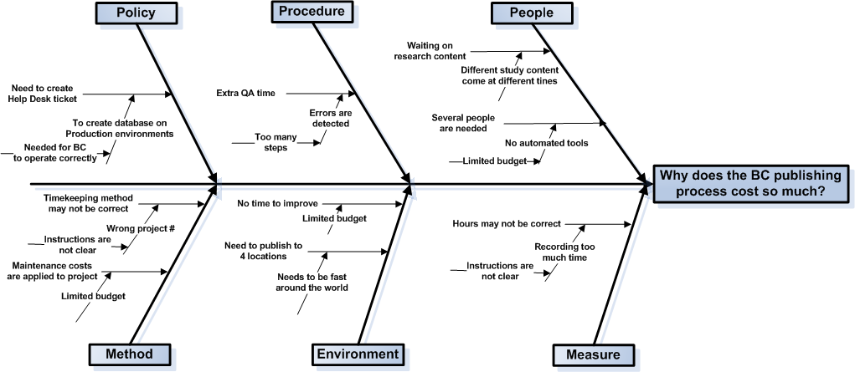
Cause & Effect Diagram

Slide 7
Major Areas for Improvement
Load data to the production environment (Publishing Process)
    Each project can have a high degree of customization
    Programmers currently need to manually move the data and other content between servers ( loading, QA, production environments)
    This process goes through a number of cycles until correct
    This includes the list of users that will have access to the study
Numerous QA Testing Checks Through the Process
    There is a quality assurance test step for each of these manual processes
    The aims is to reduce the amount of testing before a study is delivered
    This includes checking a sample of the users that will have access to the study

Slide 8
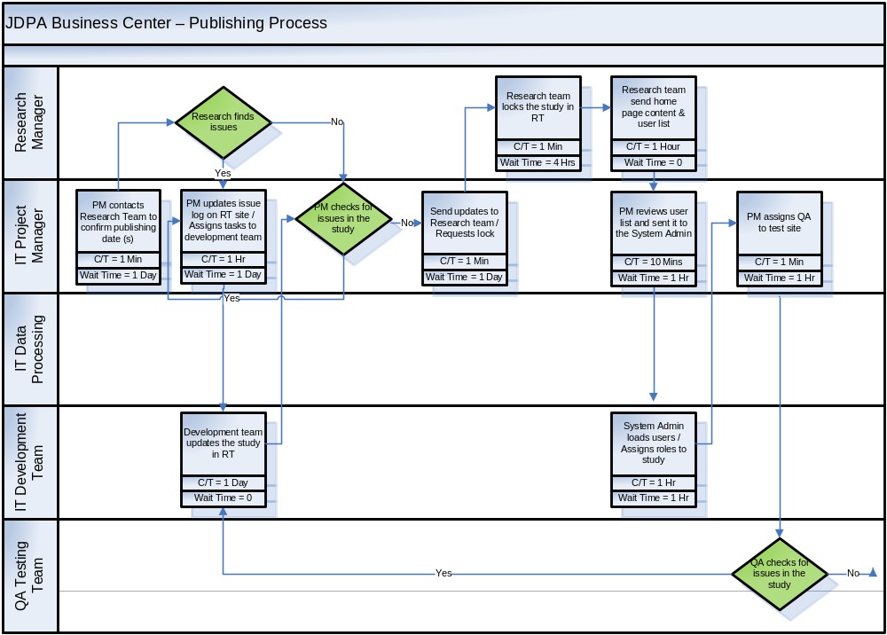
Current State Diagram
1
2
= Opportunities

Slide 9
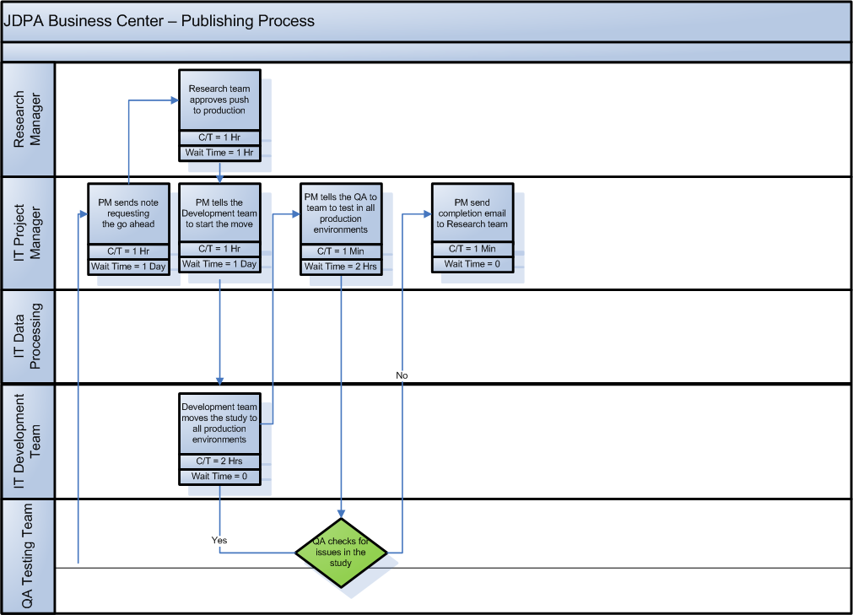
Current State Diagram
1
2
= Opportunities

Slide 10
Measurement System Analysis
An audit was conducted on the study labor hours recorded in JDPA timekeeping tool
Objective: validate the system used to record and allocate project labor
Each person on the project enters there labor hours into the JDPA timekeeping tool
A test was designed to determine if different programmers in the same group would enter different times for the same set of tasks
Timesheet data entry instructions were created that mimicked the current data entry process
The test was conducted and the results were captured in Microsoft Excel
  Number of Programmers = 4
  Number of Tasks / Scenarios = 9
  Number Total Tests = 36
The data was transferred to Minitab 16 and a capability analysis was run on the data set

Slide 11
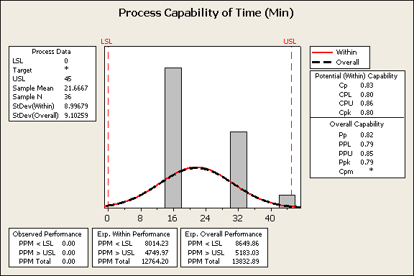
Capability Analysis
The data collected during the MSA was entered into Minitab in order to performance an Capability Analysis
DPMO = 13832.89
Sigma level = 4.5

Slide 12
Quick Wins
A quick win was identified:
  During a review of the current state diagram the team found opportunities to reduce the number of steps in the process
  The eliminated of these manual steps by the technology team already has improved the publishing of studies to the J.D. Power Business Center
  This quick win is expected to be applicable across all published study starting back in August 2011.
Notes:
The initial project charter was still rather broad – identifying a need for improvement within the broad spectrum of executing a mail-based study. In that regard, it was important for us to walk through the process and talk to process owners, practice leads, and research project managers to identify the key stakeholders and internal customers. This helped us understand the pain points throughout the process
From the walk-through and interviews, we learned a few things:
1. The existence of a number of handoffs and verification steps that have been institutionalized in our processes
2. An understanding of how scope of work changes and input variation impact our Client Operations (i.e. research production) activities, and
3. The type of data available and necessary for us to gather and analyze in order to prioritize our pain points

Slide 13
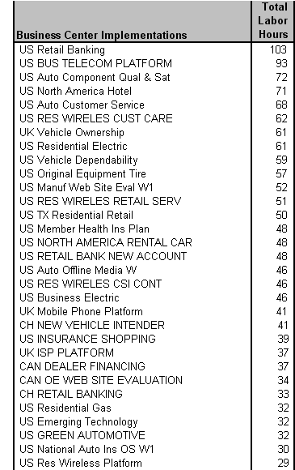
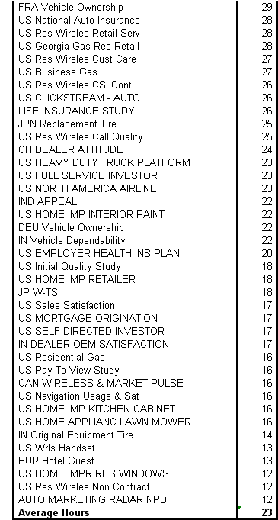
Financial Analysis - Baseline Data
1.
An average of 23 hours are spent on activities related to publishing
Source: Full labor hours capture through Timepiece. Contract labor hours captured through ActTime
Notes:
The initial project charter was still rather broad – identifying a need for improvement within the broad spectrum of executing a mail-based study. In that regard, it was important for us to walk through the process and talk to process owners, practice leads, and research project managers to identify the key stakeholders and internal customers. This helped us understand the pain points throughout the process
From the walk-through and interviews, we learned a few things:
1. The existence of a number of handoffs and verification steps that have been institutionalized in our processes
2. An understanding of how scope of work changes and input variation impact our Client Operations (i.e. research production) activities, and
3. The type of data available and necessary for us to gather and analyze in order to prioritize our pain points

Slide 14
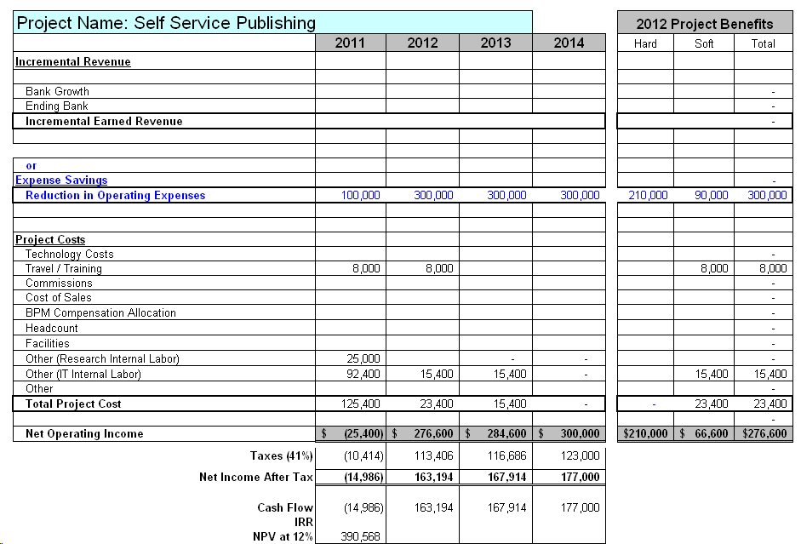
JDPA Business Case Summary

Slide 15
Assumptions
Study Assumptions
190 - Number of studies published each year
300 - Number of publishing event including wave and oversamples
70 – A sample of the study this project is focusing on for improvement
The project is excluding the most complex study that require far more then 22 hours to complete
Labor Improvement Assumptions
Improvement in IT labor hours (50%) associated with the following activities:
  Reducing project management time
  Reduce QA testing tasks
Cost Savings Assumptions
Reduce labor by 11 hours per project
$1,00 cost saving per study
100 projects in 2011, 300 project each year after
Resource Assumptions
70 % of the contract resources will be retired resulting in a hard cost saving of $210,000 in 2012.
All other resources for the soft savings will be moved to other projects outside of the syndicated
Other Assumptions
Travel: $1000/trip x 2 trips x 2 employees = $4,000
Training: $1,000/session x 4 sessions = $4,000
Two senior research managers will participate on the team as the internal customer = $25,000
Two IT programmers for 3 months will create tools to reduce the cost of the publishing process = $92,400.
No software or hardware costs. (These costs are part of the Research Tools project)

Slide 16
Next Steps
Complete the Measure stage by October 15th.
Move forward with the quick wins for the project by October 1st.

